Slide 1
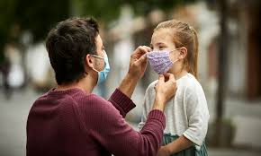
The “New Normal”
Life Post-Pandemic and how it affects Mental Health

Slide 2
Well, a lot of us are still dealing with the trauma that we've experienced over the course of the last year so a 'return to normal' isn't exactly the same normal that it used to be, and that gives people a lot of stress, and frankly, a lot of distress as well

Slide 3
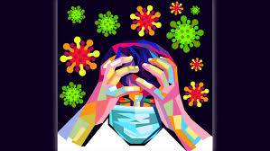
In late June 2020, the Centers for Disease Control and Prevention surveyed adults about the status of their mental health. Results showed 31% of respondents reported symptoms of anxiety or depression, 26% has stress-related symptoms, 13% reported having started or increased substance use and 11% reported having serious thoughts of suicide.

Slide 4
How do you see your mental health?
We have to see our health and mental health as absolutely intertwined and just because we get through a pandemic and begin to come out the other side on the physical health side, it doesn't mean we simultaneously do that on the mental health side as well,

Slide 5
Try to understand
* Surface the thoughts you are having
*Surface the feelings and acknowledge them
*Acknowledge those thoughts
* Acknowledge those thoughts and feelings
are real
* Talk to someone

Slide 6
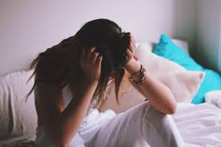
The early stages of the pandemic and the ensuing lockdowns were hard on all of us, in different ways. Isolation, joblessness, childcare, and many other challenges severely affected the mental well-being of many people around the world. Yet here we are, a year on. How are we coping?
?

Slide 7
How can we deal with anxiety, particularly if it’s affecting sleep?
1. Go Back to Basics. To mitigate anxiety and fall asleep more easily, It is suggested by professionals to implement a routine — eating breakfast, lunch, and dinner at the same time each day and also going to bed and waking up at the same time each day.

Slide 8
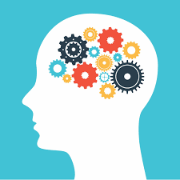
Try small exercises for the mind Write out all of their anxious feelings on a piece of paper prior to going to bed, a tactic that can help better understand fears as well as navigate potential solutions for relieving them. People have issues to deal with — loss of income, food insecurity — and all that affects the way the whole (sleeping) process works. Try to keep a worry diary of some sort, draw a column right next to it and try to figure out if there’s something within an individual’s control that they can do to exchange the circumstance.

Slide 9
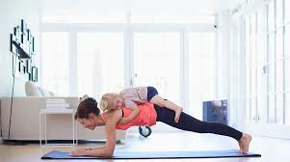
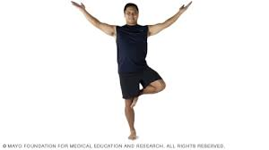
Exercise- At least 30 minutes of physical activity during the day can make a substantial difference in dealing with anxiety. It can be anything you want, it can be yoga, it can be lifting cans of soda that weigh 3 or 4 pounds, it can be walking around your neighborhood ... and it doesn’t have to be strenuous.”

Slide 10
Get outside. Especially for others who may live in a small apartment, getting outside at least once every single day is vital to alleviating feelings of claustrophobia and restlessness.

Slide 11
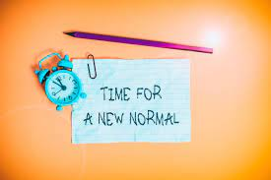
Change requires adaptation again, and that means a little bit of stress in a positive way. But the goal at the end of the road is a return to things that are going to create more of a sense of normalcy, more of a sense of connectiveness, and ultimately that will lead to a new sense of familiar.”

Slide 12
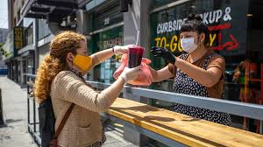
With society reopening many people are experiencing worsening social anxiety, or in some cases, newfound social anxiety. Things most people used to do daily, such as carpooling, talking to strangers, making small talk with work colleagues, and seeing old friends, have become anxiety-provoking for some.

Slide 13
How to Face Society Again
Regardless of what you need to do, keep it gradual as you work to become immersed again into society. Start with the easier things and work your way up to the harder things. You can also couple these exposures with relaxation techniques, both before, during, and after the experience, to help ease the anxiety.
Be the one in your household who goes out to get groceries.
Make a plan for how many social events you can tolerate in one day and then stick to that plan.

Slide 14
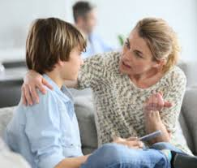
Validating Your Emotions As you are preparing to re-enter the world, your workplace, a friend group, or the broader community, it’s important to keep in mind that all of your emotions are valid right now. Whether you are feeling socially anxious, overwhelmed, stressed, or in despair, you are not alone and many others feel the same way.

Slide 15
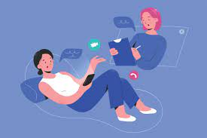
Therapy for Social Anxiety If you were previously struggling with social anxiety, you may need to seek out professional help to deal with anxiety that has gotten worse. Seeing a therapist who offers cognitive-behavioral therapy (CBT), dialectical behavior therapy (DBT), or other supportive therapies for anxiety will help. You could also consider joining a group therapy program to practice your social skills as you work on your social anxiety. While it might feel very hard to participate in therapy at the moment after being isolated for so long, it could be that your anxiety is to the point that you can’t manage it on your own anymore.

Slide 16
If you or someone you know is struggling to adjust to the new normalcy or suffering from the mental health affects of the pandemic, we are here for you!
“The one positive that can be acknowledged over 1 year later is that a newfound respect for ourselves and more confidence in abilities: We have made it on our own through a very isolating, difficult, anxiety-inducing time, and remind yourself of your own strength every day.”

Slide 17
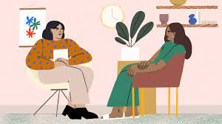
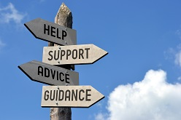
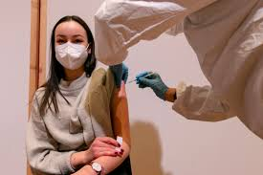
Help is always available…
Recovery Services of Northwest Ohio – 1-855-782-9920
Comprehensive Crisis Care Center- 1-800-468-4357
NAMI- Nami.org
Mentalhealth.gov
Mental health America
CDC- Center for Disease Control

