Slide 1
Self Help Meetings in the Four County Area

Slide 2
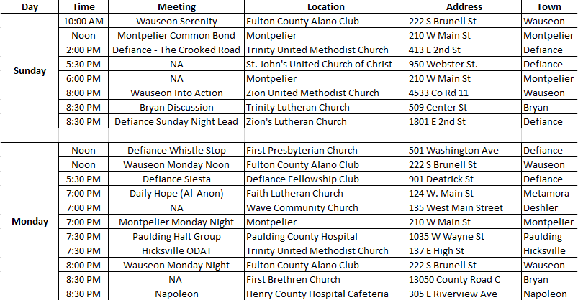
Local Self Help Meetings

Slide 3
Local Self Help Meetings

Slide 4
Local Self Help Meetings

